Slide 1
Action Elements

Slide 2
Action Elements
In this module we will see below topics
jsp: forward
jsp: include
Java Bean class
jsp: useBean
set & getProperty
Displaying applet in JSP

Slide 3
jsp: forward
JSP forward action tag is used for forwarding a request to the another resource (It can be a JSP, static page such as html or Servlet). Request can be forwarded with or without parameter.
Syntax:
1) Forwarding along with parameters.
<jsp:forward page=“Show.jsp">
<jsp:param ... />
<jsp:param ... />
<jsp:param ... />
...
<jsp:param ... />
</jsp:forward>
2) Forwarding without parameters.
<jsp:forward page="Relative_URL_of_Page" />
Relative_URL_of_Page: If page is in the same directory where the main page resides then use page name itself.
To get clear how this forward works we will see one example.

Slide 4
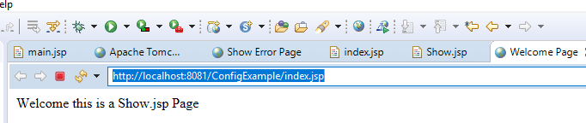
jsp: forward Example Duration : 10 min
JSP Forward Example – without passing parameters
Here we are having two JSP pages – index.jsp and Show.jsp. We have used <jsp:forward> action tag in index.jsp for forwarding the request to Show.jsp. Here we are not passing any parameters while using the action tag. In the next example we will pass the parameters as well to another resource.
index.jsp
<html>
<head>
<title>JSP forward action tag example without parameters</title>
</head>
<body>
<p align="center">This is an index page</p>
<jsp:forward page=“Show.jsp" />
</body>
</html>
Show.jsp
<html>
<head>
<title>Welcome Page</title>
</head>
<body>
Welcome this is a Show.jsp Page
</body>
</html>
After running index.jsp on browser we will see the below output.
Welcome this is a Show.jsp Page
Notes:
It is basically the content of Show.jsp, which clearly shows that index.jsp didn’t display as it forwarded the request to the Show.jsp page.

Slide 5
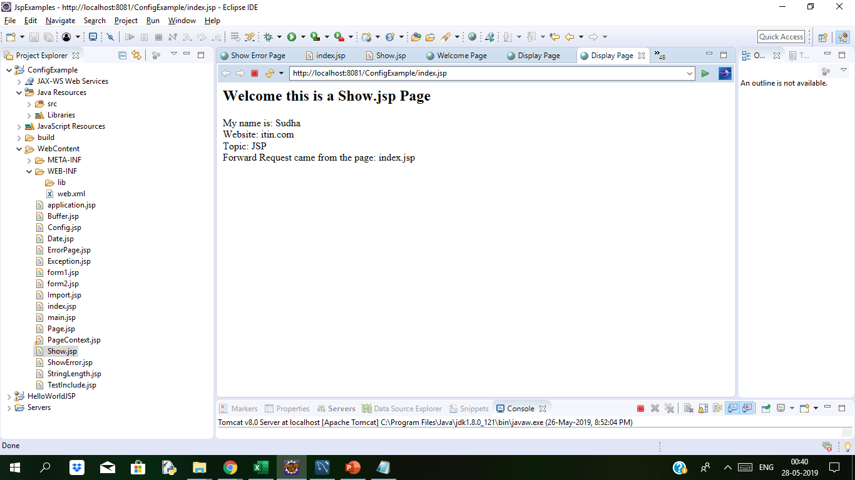
jsp: forward Example Duration : 10 min
JSP Forward Example –with passing parameters
Here we are passing the parameters along with forward request. For passing parameters we are using <jsp:param> action tag. In this example we are passing 4 parameters along with forward and later we are displaying them on the forwarded page. In order to fetch the parameters on display.jsp page we are using getParameter method of request implicit object.
index.jsp
<html>
<head>
<title>JSP forward example with parameters</title>
</head>
<body>
<jsp:forward page="Show.jsp">
<jsp:param name="name" value="Sudha" />
<jsp:param name="site" value="itin.com" />
<jsp:param name="course" value="JSP" />
<jsp:param name="reqfrom" value="index.jsp" />
</jsp:forward>
</body>
</html>
After running index.jsp on browser we will see following output.
Above code directly displayed show.jsp page, which is displaying the parameters passed from index.jsp page.
Show.jsp
<html>
<head>
<title>Display Page</title>
</head>
<body>
<h2>Welcome this is a Show.jsp Page</h2>
My name is: <%=request.getParameter("name") %><br>
Website: <%=request.getParameter("site") %><br>
Topic: <%=request.getParameter("course") %><br>
Forward Request came from the page: <%=request.getParameter("reqfrom") %>
</body>
</html>
Notes:
It is basically the content of Show.jsp, which clearly shows that index.jsp didn’t display as it forwarded the request to the Show.jsp page.

Slide 6
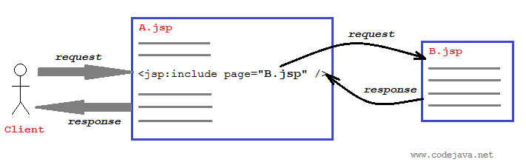
JSP:include
The <jsp:include> standard action is used to include resource into the current JSP page at request time. The included resource can be static (HTMP page) or dynamic (JSP page or servlet) and must be relative to the including JSP page. For example:
<jsp:include page="content.jsp" />
1. Syntax
The complete syntax of the <jsp:include> standard action is as follows:
<jsp:include page="relative URL" flush="true|false"/>
or:
<jsp:include page=”urlSpec” flush="true|false">
{ <jsp:param .... /> }*
</jsp:include>
The latter syntax specifies additional parameters passed to the included page using the <jsp:param> standard action:
<jsp:param name="name" value="value" />

Slide 7
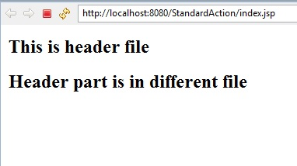
JSP:include Example Duration:10 mins
We will see example how jsp:include works
index.jsp
<html>
<head>
<meta http-equiv="Content-Type" content="text/html; charset=ISO-8859-1">
<title>Index Page</title>
</head>
<body>
<jsp:include page="header.jsp"/>
<h2>Header part is in different file</h2>
</body>
</html>
After running index.jsp page on browser we will see the following output
Header.jsp
<html>
<head>
<meta http-equiv="Content-Type" content="text/html; charset=ISO-8859-1">
<title>header file</title>
</head>
<body>
<h2>This is header file</h2>
</body>
</html>
Notes:
In the above example we are including header.jsp into index.jsp by using jsp:include action.

Slide 8
Java Bean class
The original concept of a bean—called a JavaBean—dates to 1996. It was intended to be a component model for visual elements of a program. A bean class used to aggregate or collect both primitive data types and other classes for modeling data in a program.
Mandatory for Java Bean Class
All fields, also called instance variables or properties, can only be private.
There must be a default constructor.
Methods to read or write the instance variable must begin with the prefixes set or get.
The bean class should implement the serializable interface(Optional).
Optional for Java Bean Class
The bean class should have a toString method.
The bean class should have a hashCode and an equals method
The bean class should implement the Comparable interface and have a compareTo method.
In short Java Beans are java objects that have properties,which can be read via a get method or changed via a set method.A java bean should not have any public variables. All the variables should be accessed using the getter/setter methods.

Slide 9
jsp: useBean Example Duration :20 min
In JSP we can use java beans using <jsp:useBean> Tag.The jsp:useBean element instantiates an object of the class specified by class and binds it to a variable with the name specified by ID.
Syntax of jsp:useBean action tag :
Following is syntax of <jsp:useBean>
<jsp:useBean id= "instanceName" scope= "page | request | session | application"
class= "packageName.className" type= "packageName.className“ beanName="packageName.className | <%= expression >" >
</jsp:useBean>
Where
id :Holds the unique name that is assigned to the bean
type:Is an optional attribute,which specifies the type of the class.
class:is the class name of the bean.
beanName: Is the name of bean as supplied to the instantiate() method in java.beans.Beans class.
scope:Indicates the context in which the bean should be made available.There are four types of scope available.

Slide 10
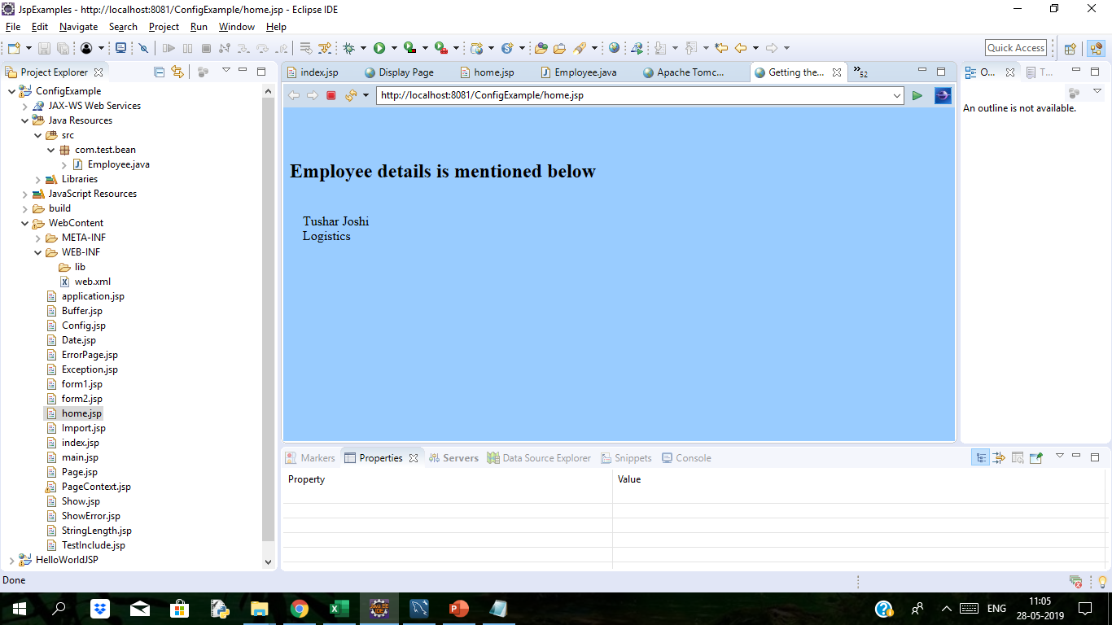
set & get Property(Example contd..)
home.jsp
<%@ page language="java" contentType="text/html; charset=ISO-8859-1"
pageEncoding="ISO-8859-1"%>
<!DOCTYPE html PUBLIC "-//W3C//DTD HTML 4.01 Transitional//EN" "http://www.w3.org/TR/html4/loose.dtd">
<html>
<head>
<meta http-equiv="Content-Type" content="text/html; charset=ISO-8859-1">
<title>Getting the Value of Bean</title>
</head>
<body bgcolor="#99CCFF">
<jsp:useBean id="employee" class="com.test.bean.Employee" />
<div>
<h2> Employee details is mentioned below</h2>
</div>
<jsp:getProperty name="employee" property="name" /><br>
<jsp:getProperty name="employee" property="department" />
</body>
</html>
You can see the following output on browser
Let us create a class Employee which will be used in JSP page.
Employee class is an example of a basic bean.
package com.test.bean;
public class Employee {
public class Employee {
private String name = "Tushar Joshi";
private String department = "Logistics";
public String getName() {
return name;}
public void setName(String name) {
this.name = name;
}
public String getDepartment(){
return department;
}
public void setDepartment(String department) {
this.department = department;
}
}
Create a jsp page
Create a jsp page inside WebContet directory of the project and name it as index.jsp . Get the value of java Bean variable using <jsp:getProperty> tag.

Slide 11
Displaying applet in JSP
Applet is java program that can be embedded into HTML pages. It runs on the java enables web browsers such as mozila and internet explorer etc.
The <jsp:plugin> action is used to generate browser-dependent HTML code (OBJECTor EMBED) that displays and executes a Java Plugin software (Java applet or a JavaBean component) in the current JSP page. The <jsp:params> and
JSP-Applet
To use applet in JSP page we can use <jsp:plugin>. By the use of <jsp:plugin> you can include an applet and JavaBean in your JSP page. Syntax of <jsp:plugin> is :
<jsp:plugin
type="bean|applet"
code="classFile"
codebase="classFileDirectory"
[ name="instancename" ]
[ align="bottom|top|middle|left|right" ]
[ height="displayPixels" ]
[ width="displayPixels" ]
[ jreversion="JREVersion" ]
................. >
[<jsp:params>
<jsp:param name="parametername"
value="parametervalue" />
..........
</jsp:params>]
[<jsp:fallback>
text message
..........
</jsp:fallback>]
</jsp:plugin>

Slide 12
Displaying applet in JSP Example Duration: 15mins
Here is code for AppletJspDemo.jsp
<%@ page language="java" contentType="text/html; charset=UTF-8" pageEncoding="UTF-8"%>
<!DOCTYPE html PUBLIC "=//W3C//DTD HTML 4.01 Transitional//EN" "http://www.w3.org/TR/html4/loose.dtd">
<html>
<head>
<meta http-equiv="Content-Type" content="text/html; charset=UTF-8">
<title>JSP Action Plugin Demo</title>
</head>
<body>
<jsp:plugin type="applet" code="TestJspApplet.class" codebase="appletCode" width="400" height="400">
<jsp:fallback>
<p>Unable to load applet</p>
</jsp:fallback>
</jsp:plugin>
</body>
</html>
When we execute above jsp page we will see applet content on browser
TestJspApplet.java file
package com.test.applet;
import java.awt.BorderLayout;
import java.awt.Color;
import java.awt.Font;
import java.awt.Graphics;
import javax.swing.JApplet;
import javax.swing.JLabel;
public class TestJspApplet extends JApplet {
private static final long serialVersionUID = 1L;
public void paint(Graphics g)
{
setBackground(Color.pink);
setForeground(Color.blue);
g.drawString("This is JSP-Applet",100,100);
}
}
We will get following display on the browser.
This is JSP-Applet
Notes:
<jsp:fallback> action
This action is an optional, direct child of the <jsp:plugin> action. Its purpose is to specify some content which is used by the client browser in case the plugin cannot be started. Common usage is to show some text that indicates there’s a problem of loading the component.
<jsp:params> action
This action is an optional, direct child of the <jsp:plugin> action. It cannot be used elsewhere. If specified, it must contain one or more <jsp:param> actions to provide additional parameters for the component.

Slide 13

Thank You

